Slide 1

BANK LOAN CASE STUDY
BY – ALANKRITA PAUL

Slide 2


TABLE OF CONTENTS
PROJECT DESCRIPTION
TASK
TECH – STACK USED
APPROACH
INSIGHTS AND RESULTS
CONCLUSION
DRIVE LINK

Slide 3

PROJECT DESCRIPTION
In this case study, we aim to provide you with a practical example of how to apply exploratory data analysis (EDA) in a business context. By utilizing the techniques you learned in the EDA module, you will also gain a fundamental understanding of risk analytics in banking and financial services. You will learn how data is used to minimize the risk of financial loss when lending to customers.
BUSINESS UNDERSTANDING :
Loan-providing companies find it difficult to provide loans to people with insufficient or non-existent credit history. Some customers take advantage of this by defaulting on their loans. In this scenario, you work for a consumer finance company that specializes in lending various loans to urban customers. To ensure that applicants capable of repaying the loan are not rejected, you must use EDA to analyze the patterns present in the data.

Slide 4


When a company receives a loan application, it needs to make a decision on loan approval based on the applicant's profile. The bank's decision involves two types of risk:
• If the applicant is likely to repay the loan, not providing the loan will result in a loss of business to the company.
• If the applicant is not likely to repay the loan, i.e. is likely to default, approving the loan can lead to a financial loss for the company.
BUSINESS OBJECTIVE :
It aims to identify patterns that indicate if a client has difficulty paying their installments which may be used for taking actions such as denying the loan, reducing the amount of loan, lending (to risky applicants) at a higher interest rate, etc. This will ensure that the consumers capable of repaying the loan are not rejected. Identification of such applicants’ using EDA is the aim of this case study.

Slide 5

TASK
Identifying Missing data and dealing with it Appropriately: Identify the missing data in the dataset and decide on an appropriate method to deal with it.
Identify Outliers in the dataset: Detect and identify outliers in the dataset.
Analyze data Imbalance: Determine if there is a data Imbalance in the loan application dataset and calculate the ratio of the data imbalance.
Perform Univariate, Segmented Univariate, and Bivariate Analysis: Perform univariate analysis to understand the distribution of individual variables, segmented univariate analysis to compare variable distributions for different scenarios, and bivariate analysis to explore relationships between variables and the target variable.
Identify top correlations for different scenarios: Segment the data based on different scenarios (e.g., clients with payment difficulties and all other cases) and identify the top correlations for each segmented data.

Slide 6




TECH-STACK USED
GOOGLE COLAB, PYTHON: FOR DATA CLEANING, ANALYZING ETC
MICROSOFT EXCEL: FOR GRAPHS/CHARTS
MICROSOFT POWERPOINT: FOR CREATING THE REPORT

Slide 7
APPROACH
DATA ACQUISITION AND FAMILIARISATION
DATA CLEANING WITH PYTHON
DATA ANALYSIS IN PYTHON
VISUALISATION IN MICROSOFT EXCEL
PROJECT REPORT

Slide 8

DATA ACQUISITION AND FAMILIARISATION:
The project began by downloading the datasets from the source. Subsequently, a thorough understanding of the datasets was gained to grasp the structures, variables, and underlying information.
DATA CLEANING WITH PYTHON:
Python programming language was utilized to clean and preprocess the datasets.
Tasks included handling missing data.
DATA ANALYSIS IN PYTHON:
After cleaning the data cleaning process, preliminary data analysis was conducted in Python. Exploratory Data Analysis (EDA) techniques were applied to extract initial insights and identify any noteworthy patterns or trends.

Slide 9

VISUALISATION IN MICROSOFT EXCEL:
The cleaned datasets were then downloaded. Microsoft Excel was used to create interactive and visually appealing graphs and visualizations. Different chart types were utilized to represent data efficiently and enable insight exploration.
PROJECT REPORT:
A comprehensive project report was made, detailing the entire process from data collection to visualization. Insights drawn from the data analysis in both Python and Microsoft Excel were documented in the report.

Slide 10
INSIGHTS AND RESULTS

Slide 11
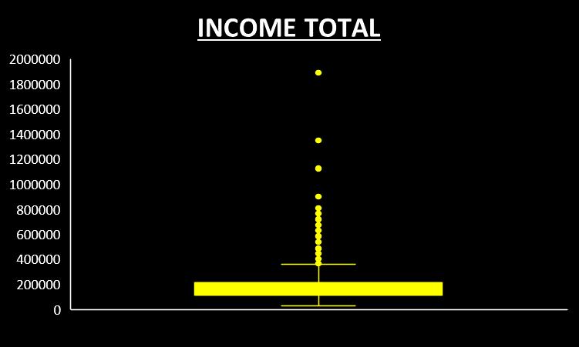

2) IDENTIFY OUTLIERS IN THE DATASET
The presence of outliers in the Income Total indicates that some individuals have significantly higher incomes compared to the majority. These outliers may represent high-income professionals or individuals with substantial investments. By understanding this distribution, financial products can be tailored and borrower risk can be assessed more accurately.

Slide 12
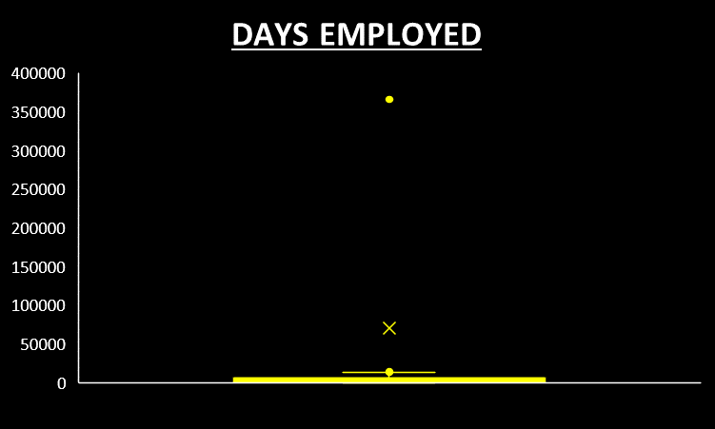
The Days Employed metric displays some outliers, indicating that a few individuals have been employed for an unusually extended period. This could imply that they are stably employed and have a lower risk of losing their jobs. Identifying these outliers helps in assessing the risk and allows for customized loan products to be offered to those who have been employed for a long time.

Slide 13
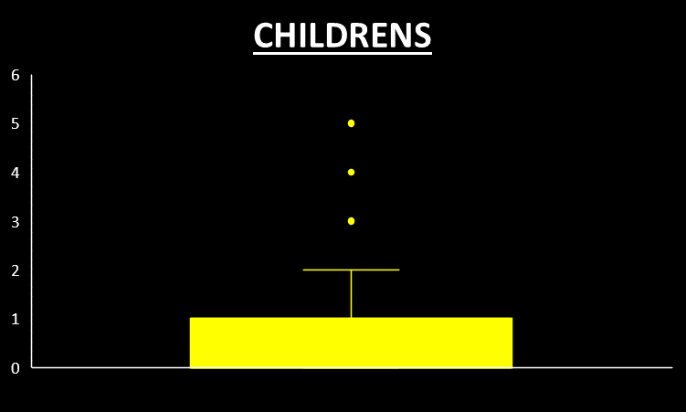
The number of children in families has a few outliers with 5 children, but the majority of families have 2 to 3 children. These outliers may indicate unique family structures or cultural dynamics. By understanding these outliers, we can design loan products that cater to the specific needs of larger families.

Slide 14
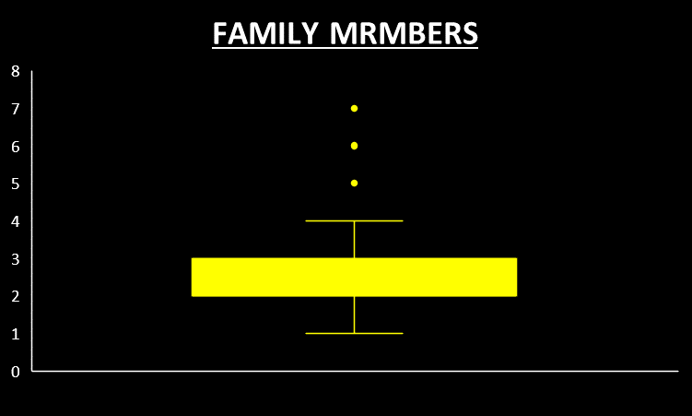
There are families with 7 members, which is uncommon, while most families have 3 or 4 members. These outliers may indicate multigenerational or joint households. Identifying these outliers could help tailor loan offerings that take into account the financial situations of larger households.

Slide 15
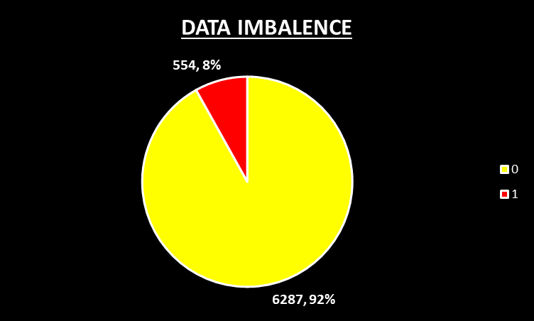

3) ANALYZE DATA IMBALANCE
The data indicates a significant class imbalance with a ratio of approximately 1:11 between non-defaulters and defaulters. This skewed distribution suggests that the number of default clients is relatively small compared to the non-default clients.

Slide 16
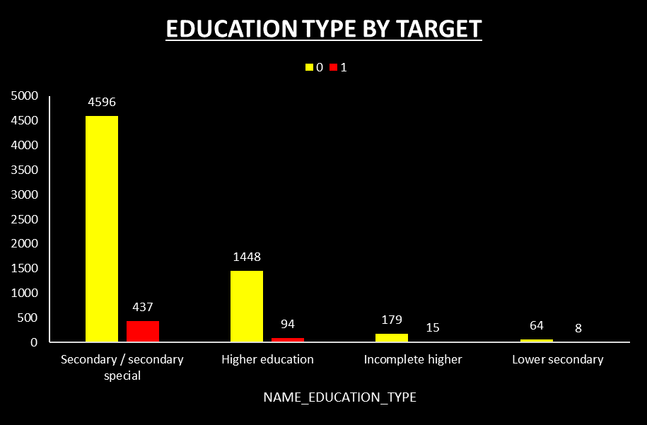

4) PERFORM UNIVARIATE, SEGMENTED UNIVARIATE, AND BIVARIATE ANALYSIS
When considering the clients’ education type, clients with secondary education are the ones who take loans most frequently, followed by clients with higher education.

Slide 17
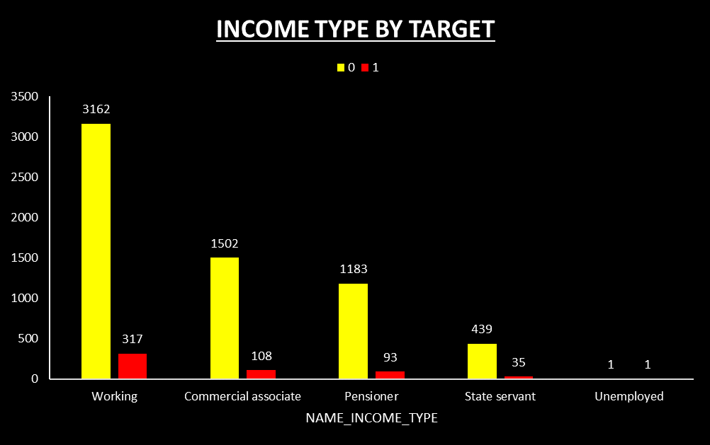
When considering clients’ income type, working and commercial associates are the clients who take most of the loans. Working clients mostly have no payment difficulties, but there are also instances of payment difficulties within this category.

Slide 18
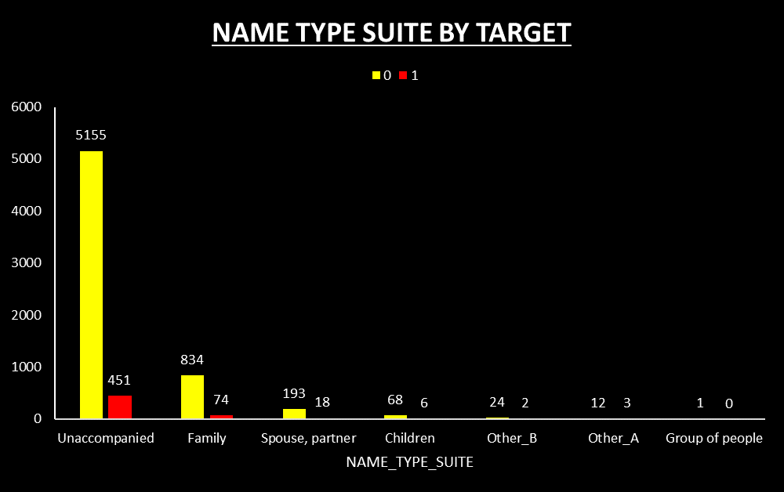

When applying for a loan, most clients come alone. These clients have the highest and the lowest default rates. However, some clients come with their family members. These clients usually have difficulties in paying back the loan.

Slide 19
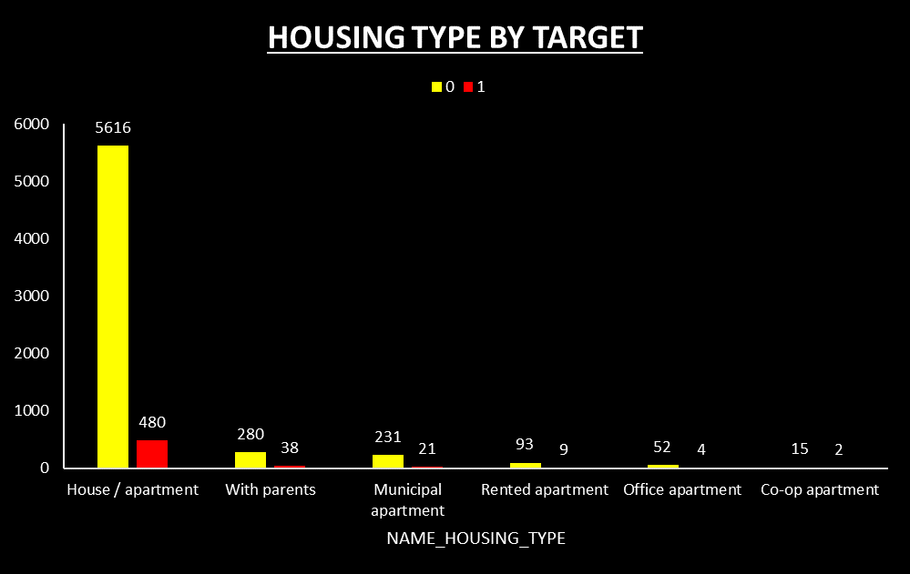
Most clients live in houses or apartments and have no payment difficulties, while clients living with their parents tend to struggle with loan payments.

Slide 20
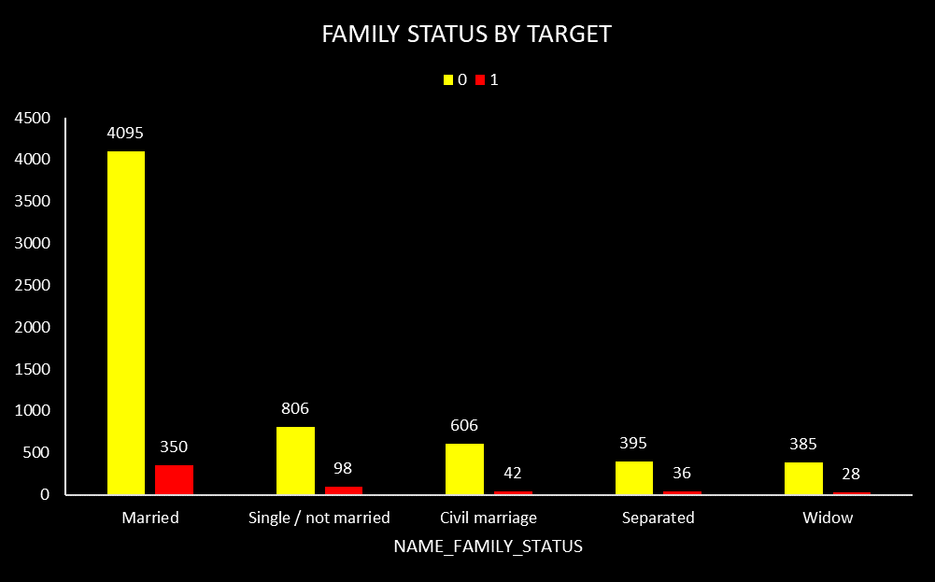
When considering clients’ family status, married clients are the ones who take out more loans. Single/not married and civil marriage clients experience higher payment difficulties.

Slide 21
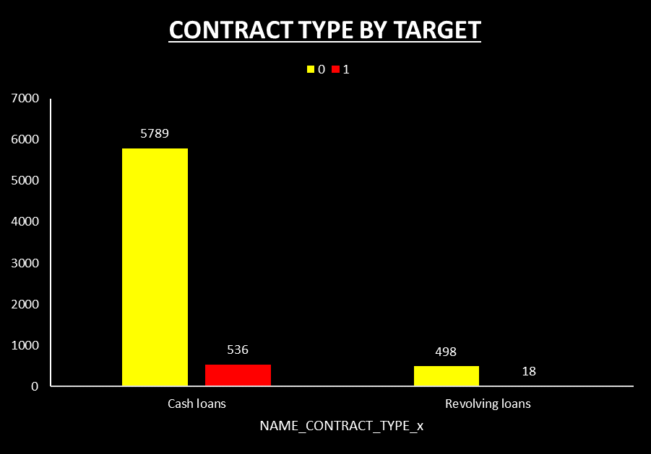
When it comes to choosing between cash loans and revolving loans, most clients opt for cash loans. However, clients who choose cash loans often struggle with repayments compared to those who choose revolving loans.

Slide 22
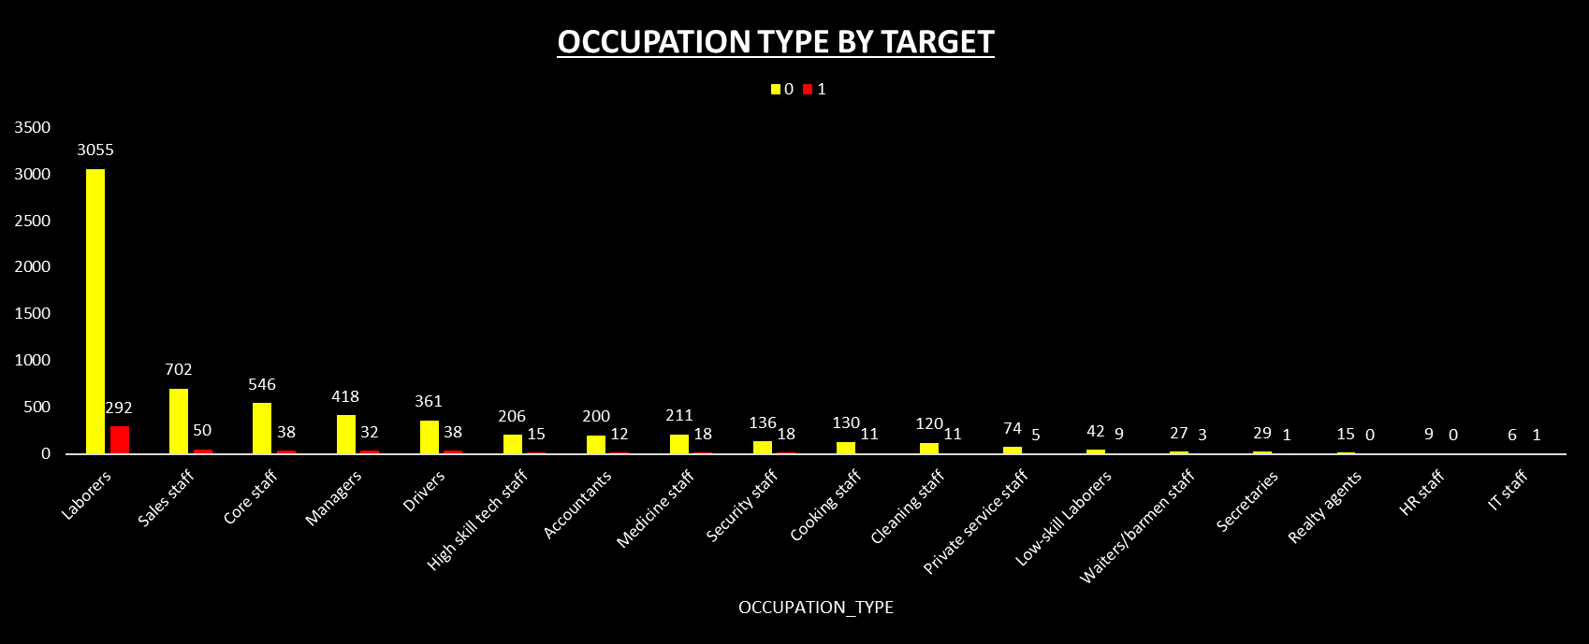
When it comes to clients' occupation type, laborers have the highest loan uptake. However, security staff, drivers, cooking staff, low-skilled laborers, and cleaning staff are more likely to face payment difficulties.

Slide 23
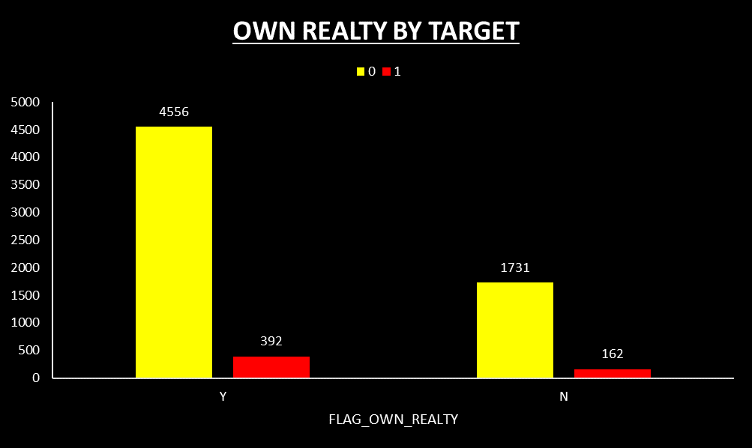
When considering whether the client owns realty, most clients do. Clients who have payment difficulties include both those who own realty and those who don’t.

Slide 24
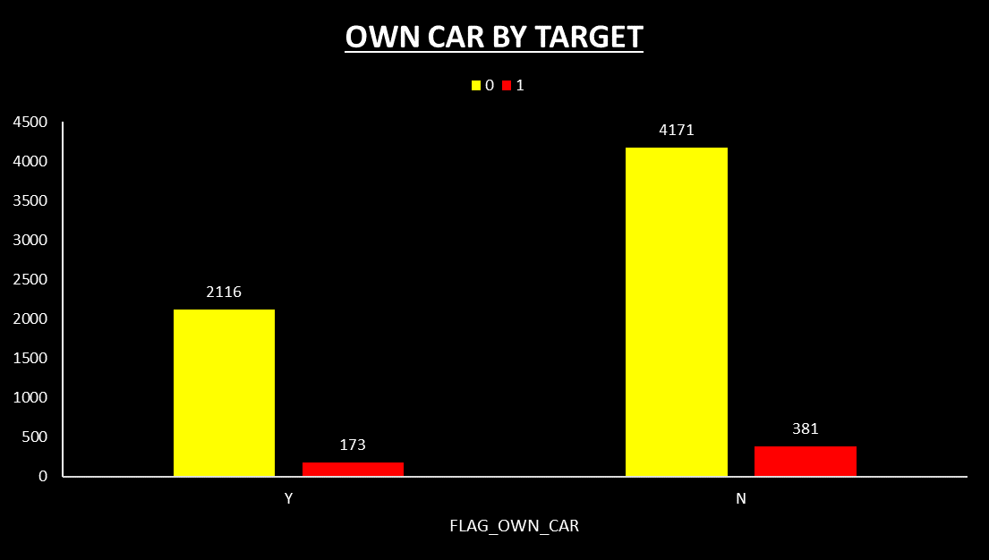
When considering whether the client owns a car, most clients do not own one. However, among the clients who do own a car, there is no significant difference in payment difficulties to those who don’t.

Slide 25
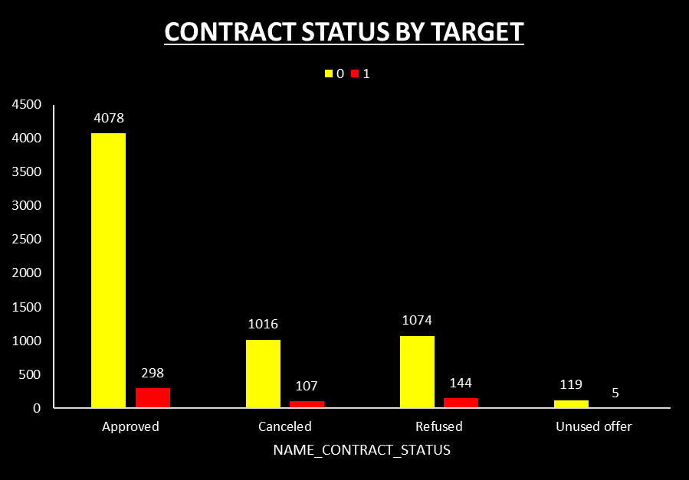

When considering the contract status, most of the loans are approved. However, it is noteworthy that some clients facing payment difficulties initially experience loan refusal for specific reasons. Subsequently, after resolving the identified issues, their loans are reevaluated and ultimately approved.

Slide 26
5) IDENTIFY TOP CORRELATIONS FOR DIFFERENT SCENARIOS

Slide 27
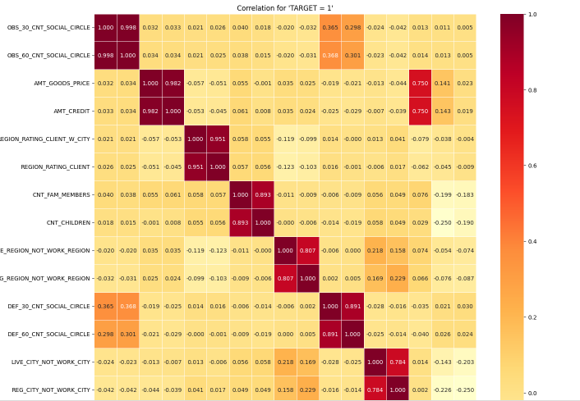
TOP 10 CORRELATION FOR TARGET = 1

Slide 28

TOP 10 CORRELATION FOR TARGET = 1
1. OBS_30_CNT_SOCIAL_CIRCLE and
OBS_60_CNT_SOCIAL_CIRCLE
2. AMT_GOODS_PRICE and AMT_CREDIT
3. REGION_RATING_CLIENT_W_CITY and
REGION_RATING_CLIENT
4. CNT_CHILDREN and CNT_FAM_MEMBERS
5. DEF_60_CNT_SOCIAL_CIRCLE and
DEF_30_CNT_SOCIAL_CIRCLE
6. LIVE_REGION_NOT_WORK_REGION and
REG_REGION_NOT_WORK_REGION
7. REG_CITY_NOT_WORK_CITY and
LIVE_CITY_NOT_WORK_CITY
8. AMT_ANNUITY and AMT_GOODS_PRICE
9. AMT_CREDIT and AMT_ANNUITY
10.DAYS_BIRTH and DAYS_EMPLOYED
The top 10 correlations with 'TARGET' = 1 reveal Significant associations within the dataset. Notably, the variables representing observations of client Social circles with observable 30 DPD and 60 DPD demonstrate an almost perfect positive correlation (0.998). Similarly, the strong positive correlation (0.983) between the goods price and credit amount suggests that clients taking larger credits tend to purchase more expensive goods. Additionally, features related to regional ratings and family size exhibit substantial positive correlations (up to 0.957 and 0.885, respectively). Moreover, clients with a history of defaults show consistent patterns over 30 and 60-day periods (correlation of 0.869). Lastly, certain features hint at connections between living and working regions (correlation of 0.848) and a trend where clients work in the same city where they live (correlation of 0.779). Overall, these correlations offer valuable insights into potential patterns and dependencies among the variables, aiding in further analysis and model development.

Slide 29
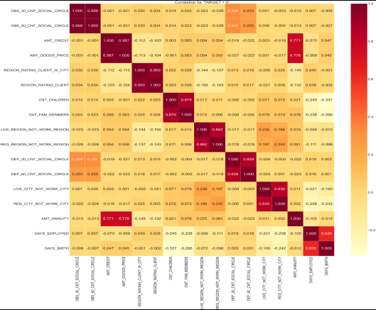
TOP 10 CORRELATION FOR TARGET = 0

Slide 30

TOP 10 CORRELATION FOR TARGET = 0
1. OBS_30_CNT_SOCIAL_CIRCLE and
OBS_60_CNT_SOCIAL_CIRCLE
2. AMT_CREDIT and AMT_GOODS_PRICE
3. REGION_RATING_CLIENT_W_CITY and
REGION_RATING_CLIENT
4. CNT_CHILDREN and CNT_FAM_MEMBERS
5. LIVE_REGION_NOT_WORK_REGION and
REG_REGION_NOT_WORK_REGION
6. DEF_30_CNT_SOCIAL_CIRCLE and
DEF_60_CNT_SOCIAL_CIRCLE
7. LIVE_CITY_NOT_WORK_CITY and
REG_CITY_NOT_WORK_CITY:
8. AMT_ANNUITY and AMT_GOODS_PRICE:
9. AMT_ANNUITY and AMT_CREDIT
10.DAYS_EMPLOYED and DAYS_BIRTH
The positive correlations indicate that there are strong relationships between these variable pairs. For instance, variables representing observations of client social circles with observable 30 and 60 DPD demonstrate almost perfect correlation (0.999). Similarly, the substantial positive correlation between AMT_CREDIT and AMT_GOODS_PRICE (0.987) implies that clients taking larger credits tend to purchase more expensive goods. Additionally, features related to regional ratings (0.950) and family size (0.879) exhibit significant positive correlations. Moreover, certain features hint at connections between living and working regions (0.862) and a trend where clients work in the same city where they live (0.830). These insights highlight the interdependencies among these variables, providing valuable information for further analysis and modeling.

Slide 31


CONCLUSION
• Based on the findings of this project, we have gained valuable insights into the characteristics and behaviors of loan applicants. The analysis of income totals revealed the existence of outliers, which refers to individuals with significantly higher incomes than the majority of applicants. This emphasizes the need to consider income disparity when evaluating borrower risk and designing financial products that cater to different income levels.
• These insights provide a detailed and thorough understanding of the characteristics of loan applicants. This understanding allows financial institutions to create customized loan products, assess borrower risk more accurately, and offer inclusive financial solutions that cater to the diverse needs of their clients. By utilizing these insights, lenders can improve their decision-making processes, encourage responsible lending practices, and support the financial well-being of their customers.

Slide 32
DRIVE LINK
Link for New Application Data.csv:
https://drive.google.com/file/d/1dbn2aSZDKgtdzFUH_4-XZggaLa_JyXL6/view?usp=sharing
Link for New Previous Application Data.csv:
https://drive.google.com/file/d/1ksJDnYL2mfUjTFxcFVD0HmdTZ6yCwbQ0/view?usp=sharing
Link for Merged Final Data.csv:
https://drive.google.com/file/d/1hEqkc5G5Ictj1U9AEiLREGi_zz5oE1Mk/view?usp=sharing
Link for Python Code Script:
https://colab.research.google.com/drive/1U8M1DA_qE3ZajjRHlWuOp7uyRhUPFW90?usp=sharing
Link for Microsoft Excel graphs :
C:\Users\admin\Desktop\Bank Loan Case.xlsx

Slide 33
THANK YOU

